Slide 1
Solving Recurrences
Algorithms & Data Structures
ITCS 6114/8114
Dr. Dewan Tanvir Ahmed
Department of Computer Science
University of North Carolina at Charlotte

Slide 2
Recurrences
Recurrence: an equation or inequality that describes a function in terms of its value on smaller functions
The expression: is a recurrence.

Slide 3

$s(n)$
$= n + s(n−1)$
$= n + n−1 + s(n−2)$
$= n + n−1 + n−2 + s(n−3)$
$= n + n−1 + n−2 + n−3 + s(n−4)$
$= …$
$= n + n−1 + n−2 + n−3 + … + n−(k −1) + s(n−k)$

Slide 4

$s(n)$
$= n + s(n−1)$
$= n + n−1 + s(n−2)$
$= n + n−1 + n−2 + s(n−3)$
$= n + n−1 + n−2 + n−3 + s(n−4)$
$= …$
$= n + n−1 + n−2 + n−3 + … + n−(k −1) + s(n−k)$
=

Slide 5
So far for n >= k we have

Slide 6
So far for n >= k we have
What if k = n?

Slide 7
So far for n >= k we have
What if k = n?

Slide 8
So far for n >= k we have
What if k = n?
Thus in general

Slide 9
T(n) =
2T(n/2) + c
2(2T(n/2/2) + c) + c
2²T(n/2²) + 2c + c
2²(2T(n/2²/2) + c) + 3c
2³T(n/2³) + 4c + 3c
2³T(n/2³) + 7c
2³(2T(n/2³/2) + c) + 7c
2⁴T(n/2⁴) + 15c
…
2^{k}T(n/2^{k}) + (2^{k} - 1)c

Slide 10
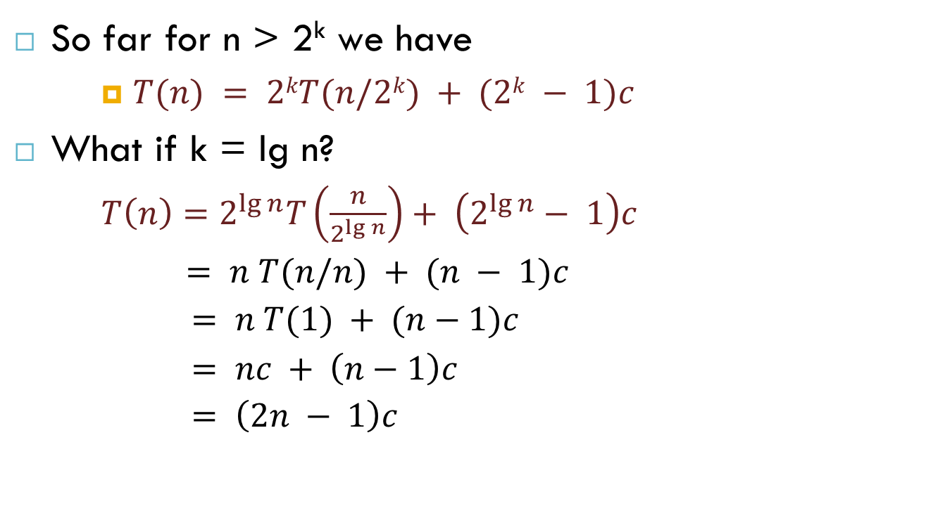
So far for n > 2^{k} we have
$T(n) = 2kT(n/2k) + (2k − 1)c$
What if k = lg n?
$T\left(n\right)=2^{\lg{n}}T\left(\frac{n}{2^{\lg{n}}}\right)+ \left(2^{\lg{n}}− 1\right)c$
$= n T(n/n) + (n − 1)c$
$= n T(1) + (n−1)c$
$= nc + \left(n−1\right)c$
$= \left(2n − 1\right)c$

Slide 11
The recursion-tree method (Cormen: 4.4)
Convert the recurrence into a tree:
Each node represents the cost incurred at various levels of recursion
Sum up the costs of all levels
Used to “guess” a solution for a recurrence

Slide 12












Example
$$W(n) = 2W(n/2) + n2$$
$$n^{2}$$
$$n^{2}$$
$$W(n/2)$$
$$W(n/2)$$
$${(n/2)}^{2}$$
$${(n/2)}^{2}$$
$$W(n/4)$$
$$W(n/4)$$
$$W(n/4)$$
$$W(n/4)$$
$$W(n/2) = 2W(n/4) + \left(n/2\right)2$$

Slide 13

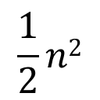






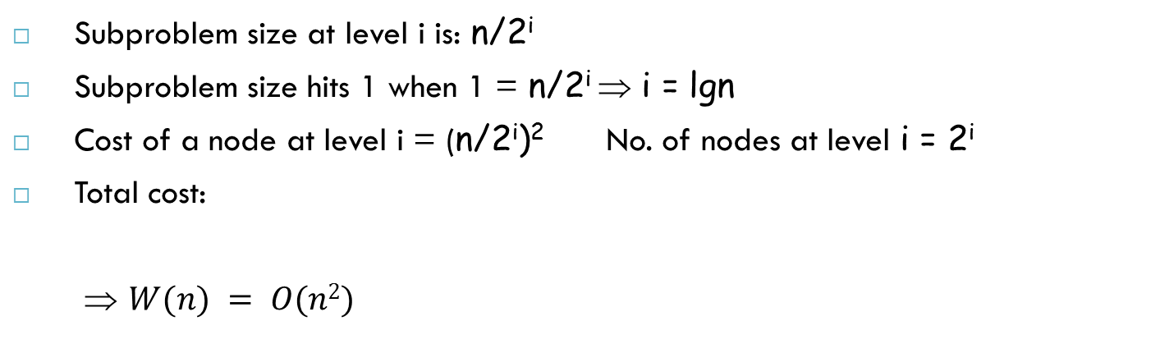



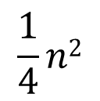
Example
$$W(n) = 2W(n/2) + n2$$
$$W(n/4) = 2W(n/8) + \left(n/4\right)2$$
$$n^{2}$$
$$n2$$
$$\frac{1}{2}n2$$
$${(n/2)}^{2}$$
$${(n/2)}^{2}$$
$${(n/4)}^{2}$$
$${(n/4)}^{2}$$
$${(n/4)}^{2}$$
$${(n/4)}^{2}$$
$$\frac{1}{4}n2$$
Subproblem size at level i is: n/2^{i}
Subproblem size hits 1 when 1 = n/2^{i} ⇒ i = lgn
Cost of a node at level i = (n/2^{i})² No. of nodes at level i = 2^{i}
Total cost:
⇒ $W(n) = O(n2)$

Slide 14
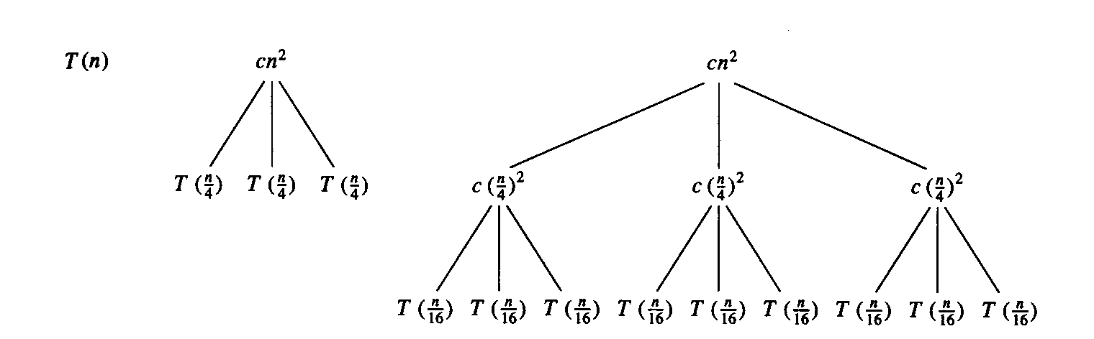
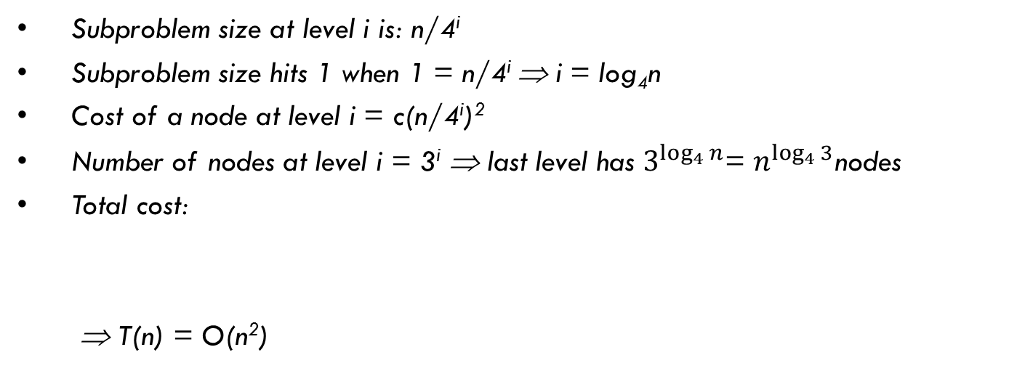

Example 2
$$T(n) = 3T(n/4) + cn2$$
Subproblem size at level i is: n/4^{i}
Subproblem size hits 1 when 1 = n/4^{i} ⇒ i = log₄n
Cost of a node at level i = c(n/4^{i})²
Number of nodes at level i = 3^{i} ⇒ last level has $3^{\log_{4}{n}}$= $n^{\log_{4}{3}}$nodes
Total cost:
⇒ T(n) = O(n²)

Slide 15
Reference
Algorithm Design: Foundations, Analysis, and Internet Examples. Michael T. Goodrich and Roberto Tamassia. John Wiley & Sons.
Introduction to Algorithms. Thomas H. Cormen, Charles E. Leiserson, Ronald L. Rivest, Clifford Stein.
Also adapted from: David Luebke

Slide 16
Thank you!

